Slide 1
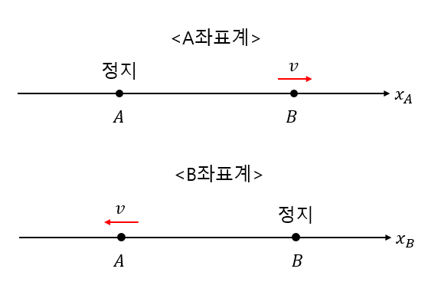








<A좌표계>
정지
$$v$$
$$x_{A}$$
$$A$$
$$B$$
<B좌표계>
$$v$$
정지
$$x_{B}$$
$$A$$
$$B$$

Slide 2







<A좌표계>
$$z_{A}$$
$$k_{A}$$
정지
$$v$$
$$x_{A}$$
$$A$$
$$B$$
$$y_{A}$$

Slide 3












<B좌표계>
$$z_{B}$$
$$k_{B}$$
$$v$$
정지
$$x_{B}$$
$$A$$
$$B$$
$$z_{B}$$
$$y_{B}$$
$$k_{B}$$
$${y′}_{B}$$
$$v$$
정지
$${x′}_{B}$$
$$A$$
$$B$$

Slide 4




<B좌표계>
$$z_{B}$$
$$k_{A}$$
정지
$$v$$
$${x′}_{B}$$
$$B$$
$$A$$
$${y′}_{B}$$

Slide 5




$$r$$
$$P$$
$$θ$$
$$O$$

Slide 6













$$R$$
$$A+B$$
$$Q$$
$$r_{0}$$
$$A$$
$$θ_{2}$$
$$r_{2}$$
$$P$$
$$B$$
$$r_{1}$$
$$O$$
$$θ_{1}$$
$$θ_{0}$$

